Slide 1
Effects on
Quality of White Wine
Baowen Dong, Tian Qi, Sabrina Li
Prof. Lan Liu
4/25/18

Slide 2
Introduction

Slide 3
Data Exploration
Source
Wine Quality Data Set [UCI Machine Learning Repository]
Number of variable, observation
N = 4898, p = 12
Research goal
classify wine quality based on properties
Mean, IQR & SD

Slide 4
Data Exploration
Variable | Mean | IQR | SD
fixed.acidity | 6.85 | 1.00 | 0.84
volatile.acidity | 0.28 | 0.11 | 0.10
citric.acid | 0.33 | 0.12 | 0.12
residual.sugar | 6.39 | 8.20 | 5.07
chlorides | 0.05 | 0.01 | 0.02
free.sulfur.dioxide | 35.31 | 23.00 | 17.01
total.sulfur.dioxide | 138.36 | 59.00 | 42.50
density | 0.99 | 0.00 | 0.00
pH | 3.19 | 0.19 | 0.15
sulphates | 0.49 | 0.14 | 0.11
alcohol | 10.51 | 1.90 | 1.23
Notes:
sd we
and we also can see the density plot shows that ….

Slide 5
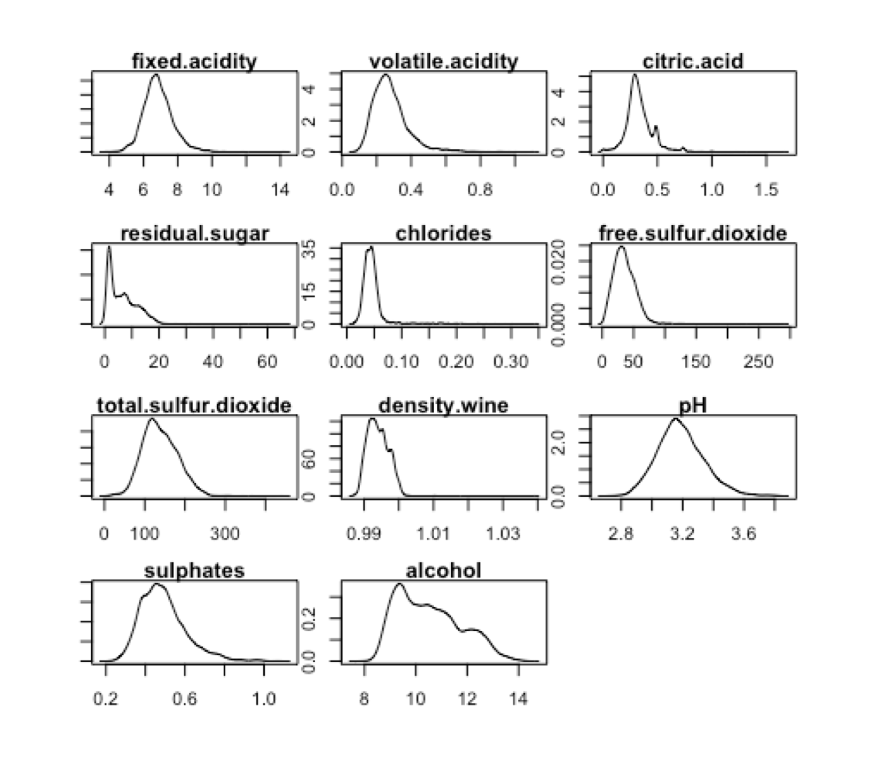
Density Plot
Notes:
we didn’t expect much variance within each variable

Slide 6
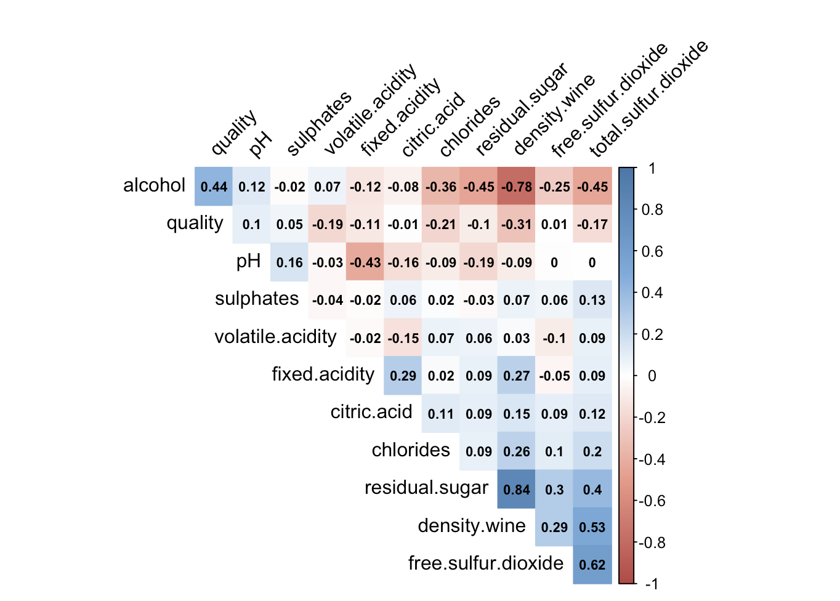
Correlation
Notes:
before fitting the model, we want to check if there’s any variables that are highly correlated with each other
pay attention to the highly correlated predictors in our model

Slide 7
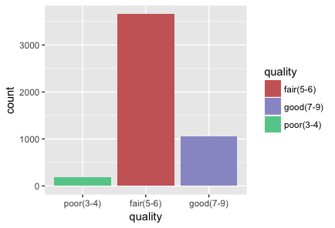
Preparation for Model Study
Separate the dataset into three classes based on wine quality
3655
1060
183 (3.7%)

Slide 8
Preparation for Model Study
Separate the dataset into three classes based on wine quality
Split the dataset into two parts - Training & Testing
Notes:
70% vs. 30%

Slide 9
Analysis

Slide 10
Proportional Odds Model
Model Building
response: Wine Quality (poor fair good)
predictors: fixed.acidity, volatile.acidity, citric.acid,
residual.sugar, chlorides, free.sulfur.dioxide,
total.sulfur.dioxide, density, ph, sulphates, alcohol.
11 predictors
Model Selection by AIC criterion
final model: “alcohol” and “chlorides” are dropped.
polr() in MASS package, step() for AIC

Slide 11
Proportional Odds Model’s Prediction
Confusion Matrix
Confusion Matrix |  | Predicted Class
 |  | good | fair | poor
Actual Class | good | 85 | 227 | 0
 | fair | 65 | 1029 | 2
 | poor | 0 | 59 | 3
misclassification rate: 24%

Slide 12
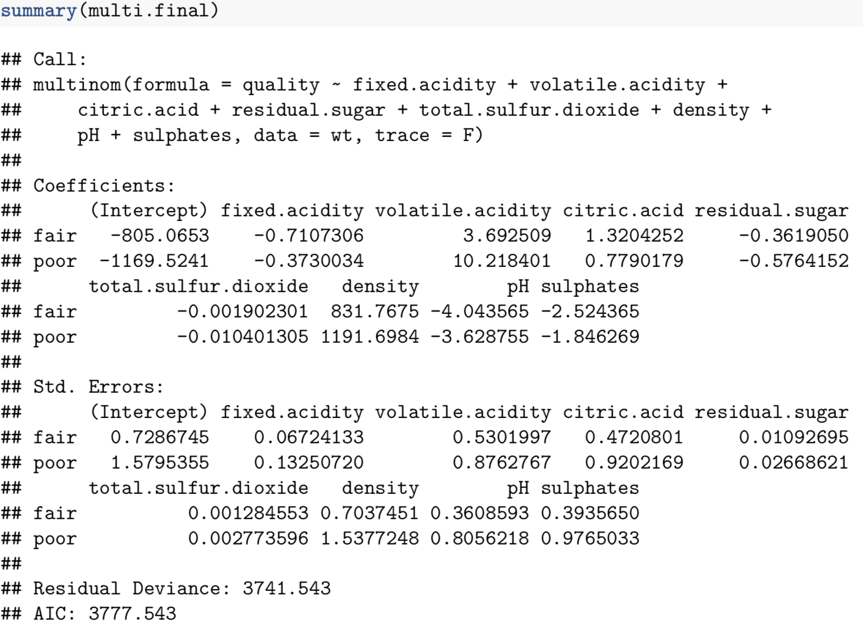
Multinomial Logistic Regression Model
Besides “alcohol” and “chlorides”, free.SO2 is not significant either.
Feature Selection

Slide 13
Multinomial Model
Confusion Matrix
Confusion Matrix |  | Predicted Class
 |  | good | fair | poor
Actual Class | good | 90(85) | 222(227) | 0
 | fair | 73(65) | 1020(1029) | 3(2)
 | poor | 1(0) | 58(59) | 3
misclassification rate: 24.28%
*number in () is the prediction of proportional odds model
Prediction & Problem

Slide 14
KNN
Confusion Matrix (with k=1)
Confusion Matrix |  | Predicted Class
 |  | good | fair | poor
Actual Class | good | 174(85) | 134(227) | 4(0)
 | fair | 188(65) | 891(1029) | 17(2)
 | poor | 9(0) | 41(59) | 12(3)
misclassification rate: 26.73%
*number in () is the prediction of proportional odds model
Prediction & Problem

Slide 15
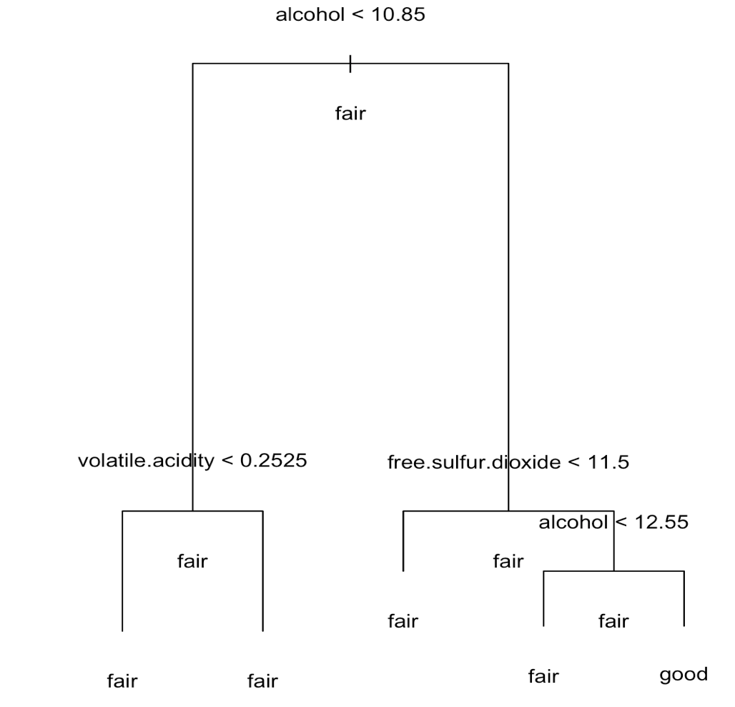
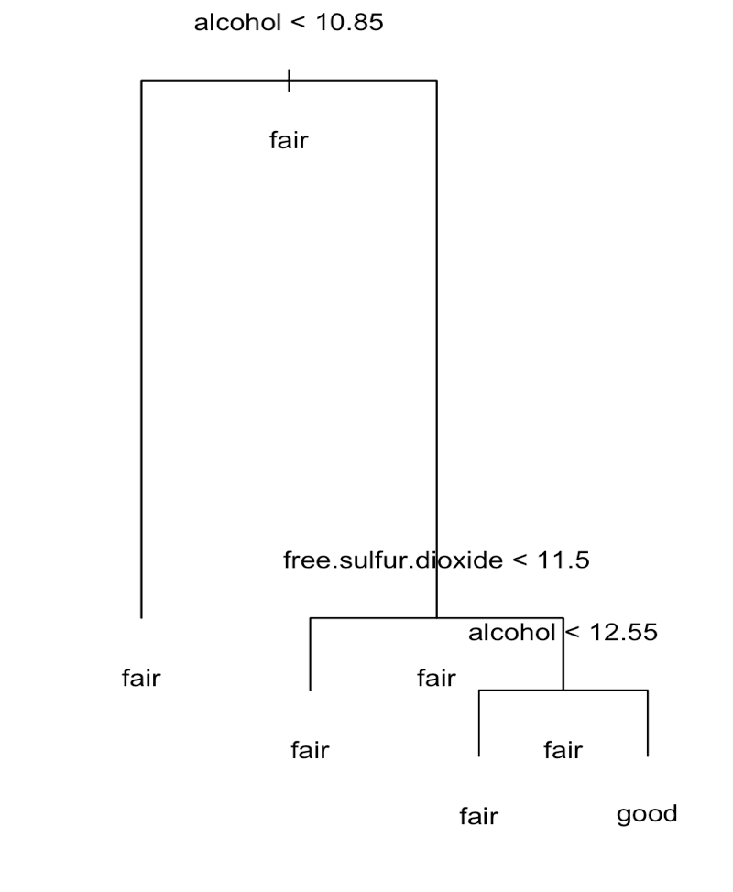
Classification Tree
After CV
Before CV
(tree size=5)
After CV
(tree size=4)
Visualization & Problem
Notes:
prune the tree - number of terminal nodes
Prune back the tree to avoid overfitting the data.

Slide 16
Classification Tree
Confusion Matrix
Confusion Matrix |  | Predicted Class
 |  | good | fair | poor
Actual Class | good | 251(101) | 61(211) | 0(0)
 | fair | 32(72) | 1064(1024) | 0(0)
 | poor | 62(0) | 0(0) | 0(0)
misclassification rate: 23.46%
*number in () is the prediction before pruning the tree
Prediction Result & Problem
Notes:
poor < 5%
62: at least should be classified as fair

Slide 17
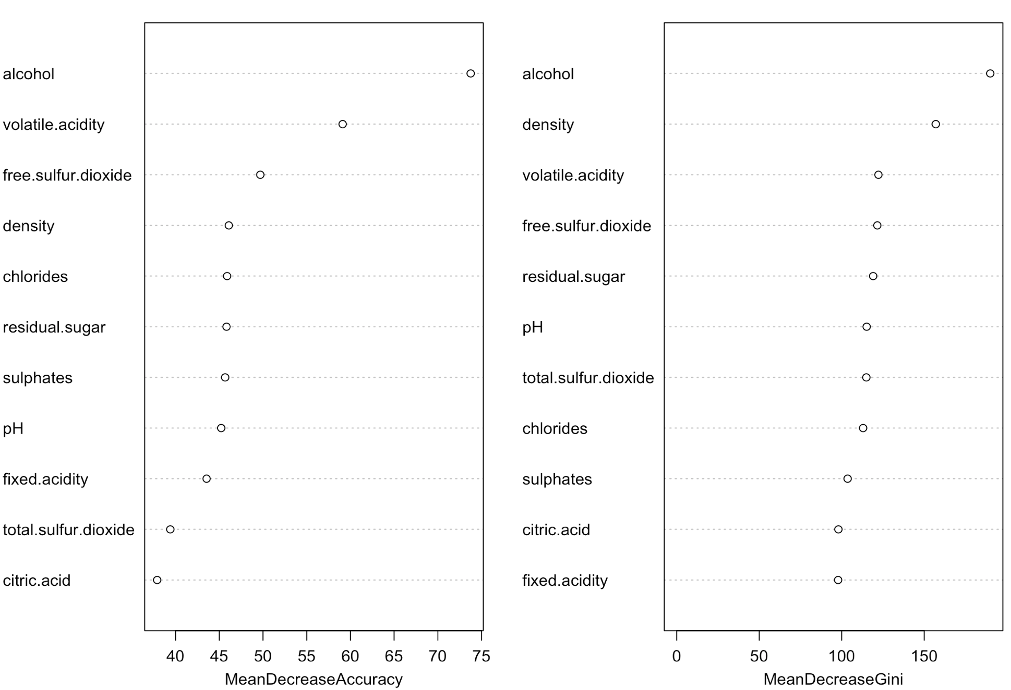
Random Forest
Variable Importance
Notes:
mean decrease accuracy & gini
variables having slightly different rankings across both metrics
compare with prop.odds - drop alcohol - why got different prediction

Slide 18
Random Forest
Confusion Matrix (before & after tuning parameter)
Confusion Matrix |  | Predicted Class
 |  | good | fair | poor
Actual Class | good | 194(193) | 118(119) | 0(0)
 | fair | 60(57) | 1036(1037) | 0(2)
 | poor | 1(1) | 52(53) | 9(8)
misclassification rate: 15.7%
(OOB estimate of error rate: 15.9%)
*number in () is the prediction before tuning parameter
Prediction Result

Slide 19
Proportional Odds Model’s Prediction
Confusion Matrix
Confusion Matrix |  | Predicted Class
 |  | good | fair | poor
Actual Class | good | 85 | 227 | 0
 | fair | 65 | 1029 | 2
 | poor | 0 | 59 | 3
misclassification rate: 24%
Compare with proportional odds

Slide 20
Support Vector Machine
Confusion Matrix
Confusion Matrix |  | Predicted Class
 |  | good | fair | poor
Actual Class | good | 183 | 129 | 0
 | fair | 89 | 992 | 15
 | poor | 3 | 41 | 18
misclassification rate: 18.8%
(kernel: radial, gamma=0.09)
Prediction Result
Notes:
(kernel: radial, gamma=0.09)

Slide 21
Summary

Slide 22
Summary
Model | Accuracy
Proportional Odds | 76.0%
Multinomial Logistic Regression | 75.7%
K-Nearest Neighbors | 73.3%
Random Forest | 84.2%
Support Vector Machine | 81.2%
Notes:
unbalanced
data fair 太多，倾向于predict fair
组分的不好，换一个分组方式
实际情况就是fair的酒，poor和good
提高quality
没有抓到 key factors - 下一步找决定性的因子（一个一个fit）
data unbalance

Slide 23
Future Work
Choose different ways to separate the classes
Find out the key factors
Improve the wine quality
Notes:
by fitting the model with each variables
after we capture the main features, we might be able to provide some suggestions to improve the wine quality

Slide 24
Thank you!
Q&A

